Slide 1

CHEF SOCIET Y
GROUP NO.15

Slide 2

CONTENTS
01
INTRODUCTION
02
OBJECTIVES
03
METHODOLOGY
04
REQUIREMENTS
05
DEMONSTRATION
06
PROJECT PLAN
07
INDIVIDUAL CONTRIBUTION

Slide 3
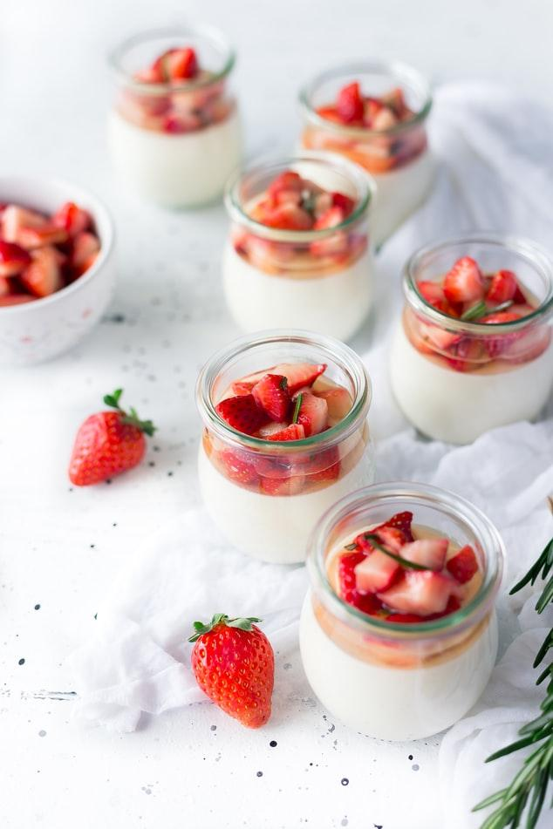
INTRODUCTION
1
The proposed project is an Android Application called “Chef Society”, that will provide recipes to the users based on different categories.
“Chef Society” makes finding recipes easy.
Provides user flexibility to search, view and save recipes based on different categories with an additional capability for creating own new recipe and deleting recipe that are no longer required.

Slide 4
This app aspires to run efficiently, while having an intuitive a simple design that provides the user all the necessary functionalities.
Through this application we earn by using advertisement. Mainly advertisements are focus in the hotel industry. Development of our application helps hotel managers to increase their customers.
This application is a time saver providing recipes in few clicks. The user is given choice to create personal cookbook,
where user can create recipe, view recipe
and delete recipe.
The interface is clean and simple.

Slide 5

OBJECTIVES
2
Design & develop an efficient system that enable user to search for recipes.
Well meet the client’s demands.
Help users cook great food with the recipes which are easy to understand and even easier to make.
Help to find the proper source for recipes to cook for a beginner.
To help save the user money and time by tediously referencing cook books and buying ingredients he does not need.
Increase better partnerships and cooperation

Slide 6
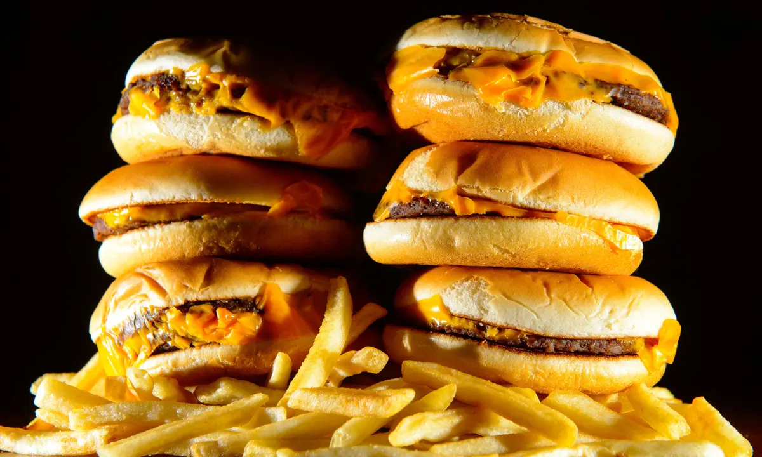
METHODOLOGY
3
Agile methodology for mobile application development puts forward the option for clients to improvise and suggest changes in the project before it is completed.
In Agile Software Development interactions and personnel are more important than processes and tools, software that functions more important than complete documentation, collaboration with clients is more important than contract negotiation, and the attitude of responding to change is more important than following the plan.

Slide 7
Agile Method has a way of working close to the client, using this method the client will be able to directly assess the running of the application and what things are missing and need to be added to the application.
There is a high return on investment due to the iterative nature of the app and the speedy development process due to the teamwork involved.
Due to the teamwork and scope of improvisation at every step, there is a highly reduced risk of any errors or mistakes in the application development process.
Responsiveness is increased in this methodology because of the constant customer feedback and the addition of new features instantly according to the requirement and changing preferences of the audience.
So we decided to use Agile Methodology to develop our
mobile app successfully.

Slide 8
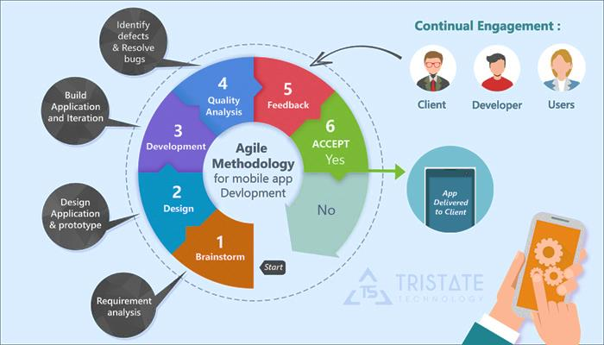

Slide 9

FUNCTIONAL REQUIREMENTS
4
Register
Login
View Profile
Edit Profile
View Recipe
Create Recipe
Add Recipes as Favorite
View My Recipes
Delete Recipes
View My Favorite Recipes

Slide 10
Comment
Smart Search filter
Calorie Calculator (Updated)
BMI Calculator (Updated)
Q & A Forum : Users can share their problems and idea through this forum and Moderator will answer user's concerns and general questions.
Services Marketing Platform :
Develop the system to provide job opportunity to Users.
They can apply for the job by providing their talent
in different aspects.

Slide 11

NON- FUNCTIONAL REQUIREMENTS
The application shall be easy to use and intuitive.
The application shall have a user-friendly interface.
GUI shall be simple and clear.
The application shall be fast and robust when loading.
The application shall not produce an incorrect output.
The application shall conform to ISO standards.
The application shall be protected from any external danger or attacks.

Slide 12
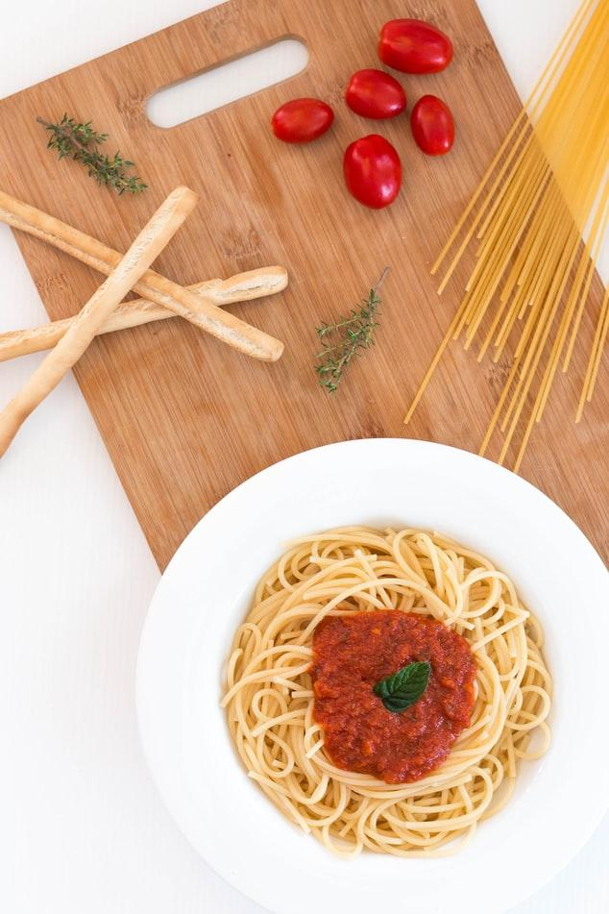
HARDWARE
REQUIREMENTS
OS – Windows
RAM - 8GB minimum (16GB recommended + SSD)
Disc Space - 10GB for Android Studio, at least 1.5GB for Android SDK, emulator system images and caches.
Mobile Phone - Xiaomi Redmi Note 4 3
Internet connection - WIFI , Mobile network

Slide 13

SOFTWARE REQUIREMENTS
Flutter
Firebase
Dart

Slide 14

DEMONSTRATION
5

Slide 15
PROJECT PLAN
6
Task | Time (Weeks)
 | 1 | 2 | 3 | 4 | 5 | 6 | 7 | 8 | 9 | 10 | 11 | 12 | 13 | 14 | 15
Groups & Identify topic
Introductory session
Create proposal
proposal submission
proposal presentation
Progress Report 01
Progress presentation
Progress Report 02
Interim Report Submission
Interim Presentation
Progress Report 03
Progress Report 04
Progress Report 05
Final report submission
Final Presentation

Slide 16

INDIVIDUAL CONTRIBUTION
7
Registration Number | Member Name | Contribution
UWU/CST/18/012 | Dilshan K.Y.T | Home Page Add New Recipe View Recipe Q & A Forum UI Designing
UWU/CST/18/035 | Bandara C.J.M.H | Calorie Calculator BMI Calculator Admin Management UI Designing
UWU/CST/18/049 | Sewwandi M.G.S.I | Documentation Register & Login Page Smart Search Filter in Recipes UI Designing
UWU/CST/18/054 | Kumara R.M.R.S.C | Services Marketing Platform Smart Search Filter in Services Marketing Platform User Profile Management UI Designing

Slide 17

THANK YOU !

